Slide 1
PERC
Tony Mason
Introduction
Persistence Efficient Recoverable Consistent Conclusions
PERC: Persistent, Efficient, Recoverable, Consistent
William Anthony Mason
¹Department of Computer Science The University of British Columbia
December 14, 2018

Slide 2



PERC
Tony Mason
1
Introduction
Introduction
Persistence Efficient Recoverable Consistent Conclusions
2
Persistence
3
Efficient
4
Recoverable
5
Consistent
6
Conclusions

Slide 3




Outline
PERC
Tony Mason
1
Introduction
Introduction
Persistence Efficient Recoverable Consistent Conclusions
2
Persistence
3
Efficient
4
Recoverable
5
Consistent
6
Conclusions

Slide 4

Memory
PERC
Tony Mason
Introduction Persistence Efficient Recoverable Consistent Conclusions
Without memory, there is no culture. Without memory, there would be no civilization, no society, no future.
— Elie Wiesel

Slide 5
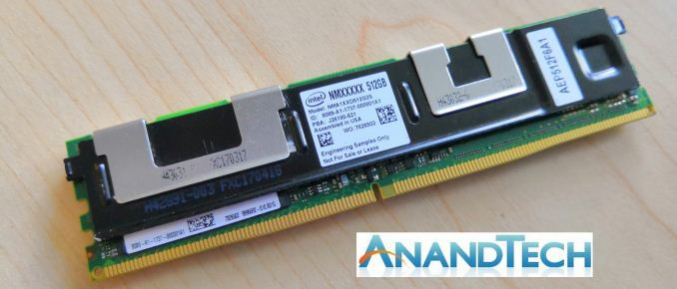
Non-Volatile RAM
PERC
Tony Mason
Introduction Persistence Efficient Recoverable Consistent Conclusions

Slide 6
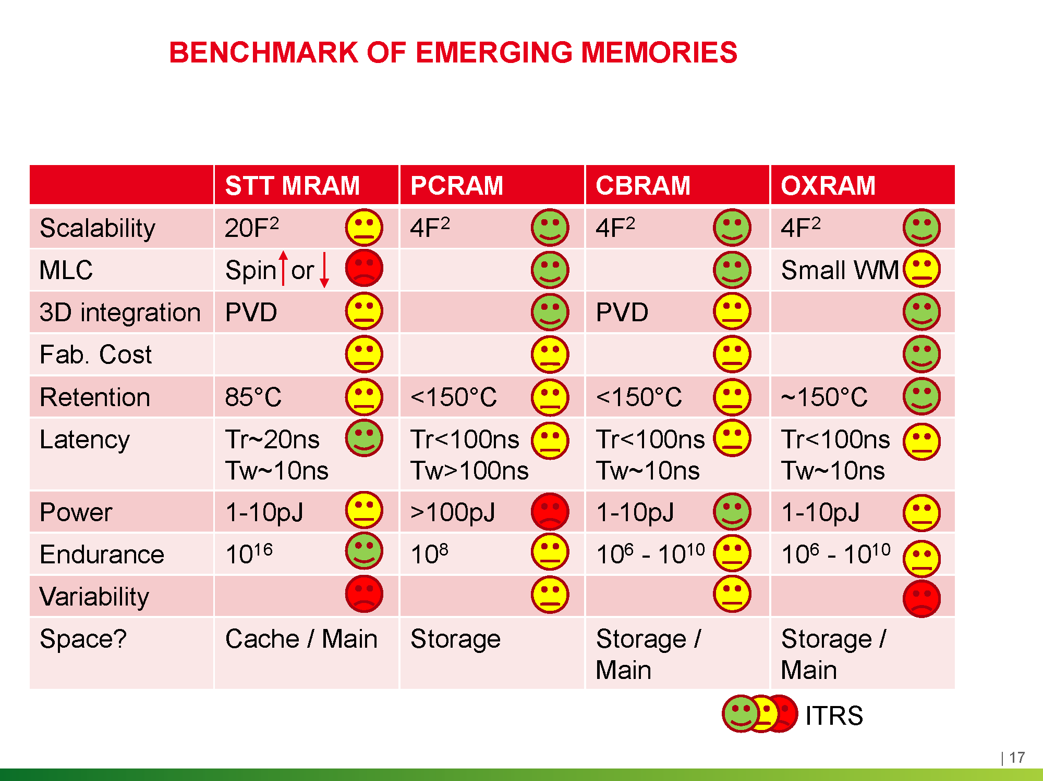
NVRAM Technologies
PERC
Tony Mason
Introduction Persistence Efficient Recoverable Consistent Conclusions
Source: Breaking the Memory Bottleneck in Computing Applications with Emerging Memory Technologies: a Design and Technology Perspective

Slide 7

Outline
PERC
Tony Mason
1
Introduction
Introduction
Persistence Efficient Recoverable Consistent Conclusions
2
Persistence
3
Efficient
4
Recoverable
5
Consistent
6
Conclusions

Slide 8

Persistence
PERC
Tony Mason
Introduction Persistence Efficient Recoverable Consistent Conclusions

Slide 9
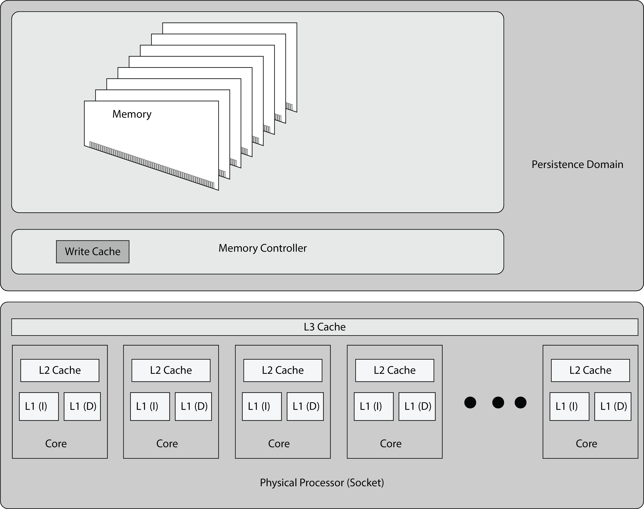
Persistence
PERC
Tony Mason
Introduction Persistence Efficient Recoverable Consistent Conclusions

Slide 10
Outline
PERC
Tony Mason
1
Introduction
Introduction
Persistence Efficient Recoverable Consistent Conclusions
2
Persistence
3
Efficient
4
Recoverable
5
Consistent
6
Conclusions

Slide 11
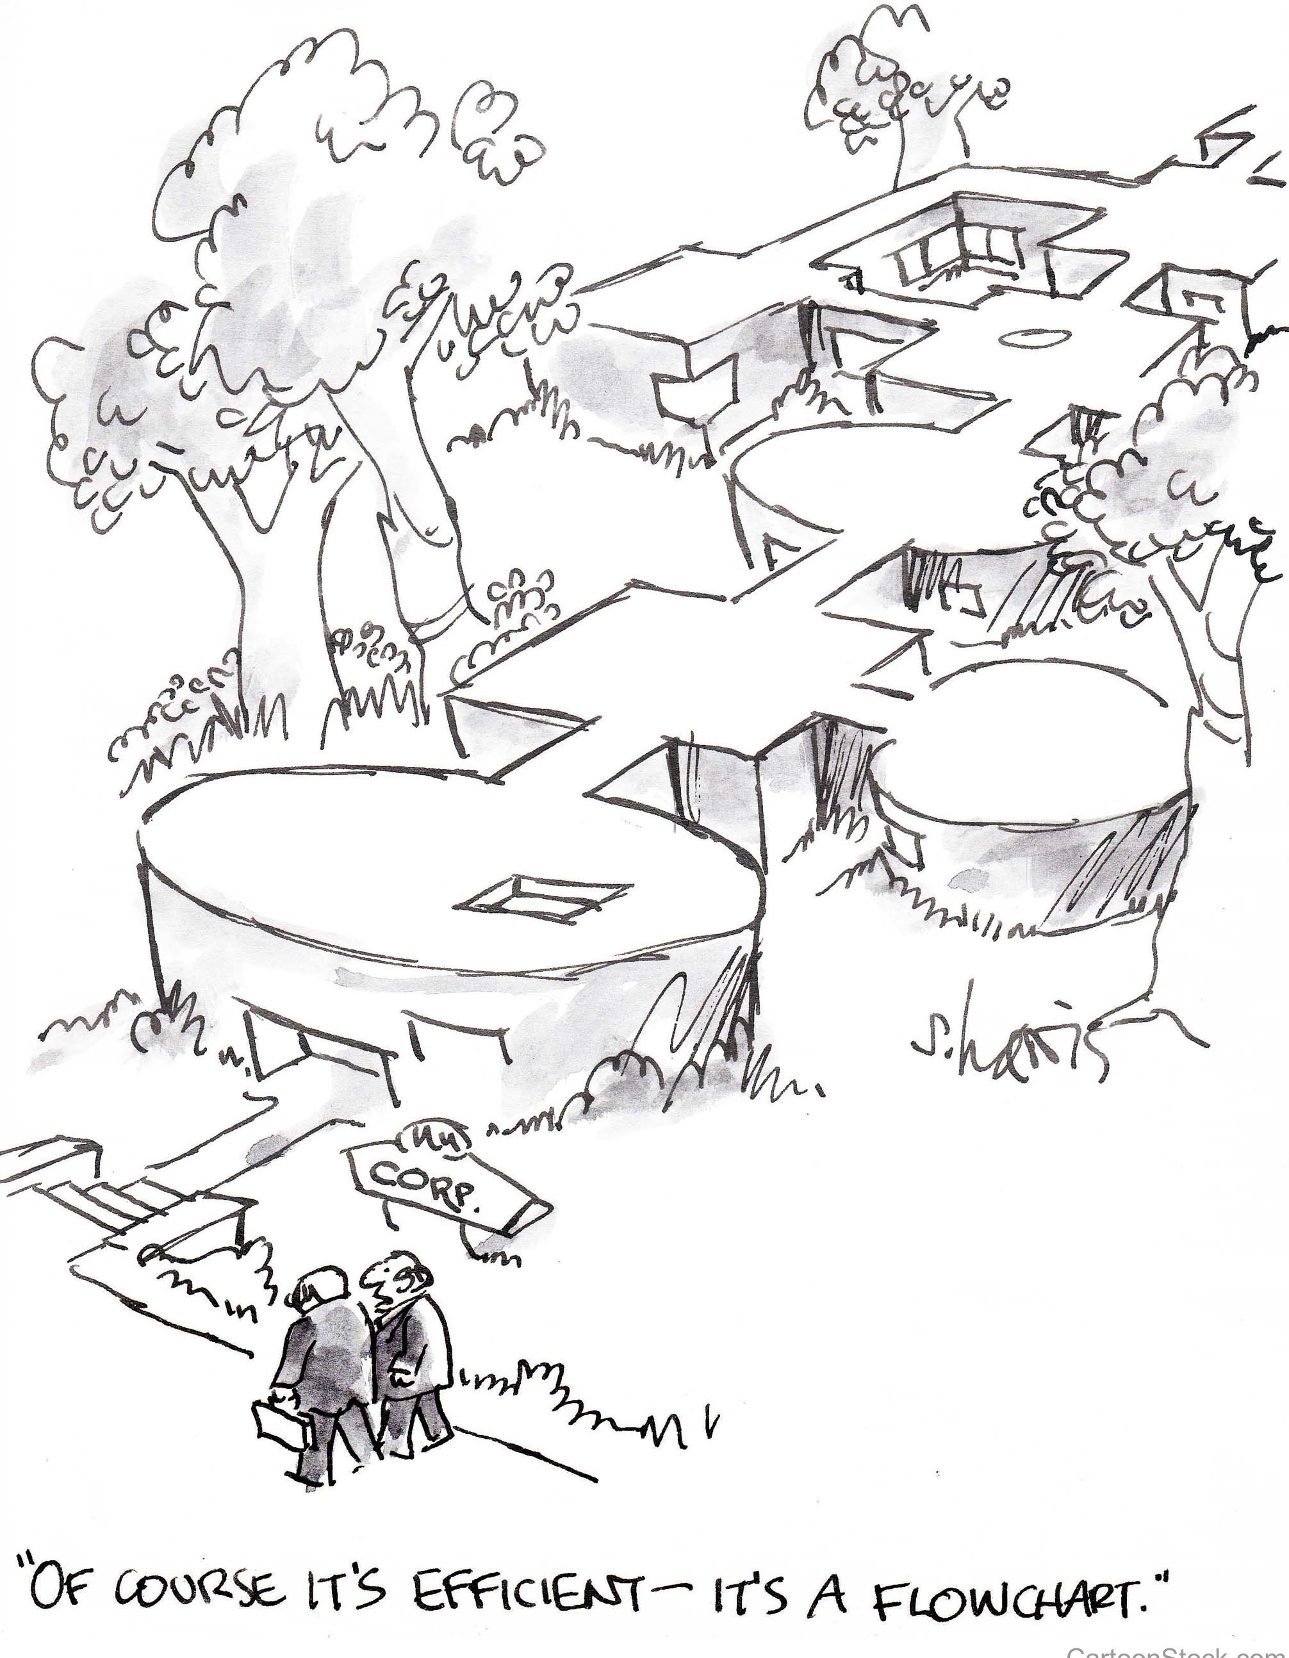
Efficient
PERC
Tony Mason
Introduction Persistence Efficient Recoverable Consistent Conclusions

Slide 12
Efficient
PERC
Tony Mason
Sequential Copy Multi‐NVM Single‐DRAM
6E+09
5E+09
4E+09
3E+09
2E+09
1E+09
0
1 2 3 4 5 6 7 8 9 10 11 12 13 14 15 16 17 18 19 20
Core Count
NVM Ticks (Average) DRAM Ticks (Single Core)
Sequential Copy Single‐NVM Multi‐DRAM
2.4E+09
2.2E+09
2E+09
1.8E+09
1.6E+09
1.4E+09
1.2E+09
1E+09
800000000
1 2 3 4 5 6 7 8 9 10 11 12 13 14 15 16 17 18 19 20
Core Count
NVM Ticks (Single Core) DRAM Ticks (Average)
Introduction
Persistence Efficient Recoverable Consistent Conclusions
Click Ticks
Click Ticks
Sequential Copy Multi‐eNVM Single‐DRAM
Sequential Copy Single‐eNVM Multi‐DRAM
5E+09
4E+09
3E+09
2E+09
1E+09
0
3E+09
2.5E+09
2E+09
1.5E+09
1E+09
500000000
0
CPU Ticks
CPU Ticks
1 2 3 4 5 6 7 8 9 10 11 12 13 14 15 16 17 18 19 20
eNVM Cores
eNVM Ticks/core DRAM Ticks
1 2 3 4 5 6 7 8 9 10 11 12 13 14 15 16 17 18 19 20
DRAM Cores
eNVM Ticks DRAM Ticks/core

Slide 13
Outline
PERC
Tony Mason
1
Introduction
Introduction
Persistence Efficient Recoverable Consistent Conclusions
2
Persistence
3
Efficient
4
Recoverable
5
Consistent
6
Conclusions

Slide 14
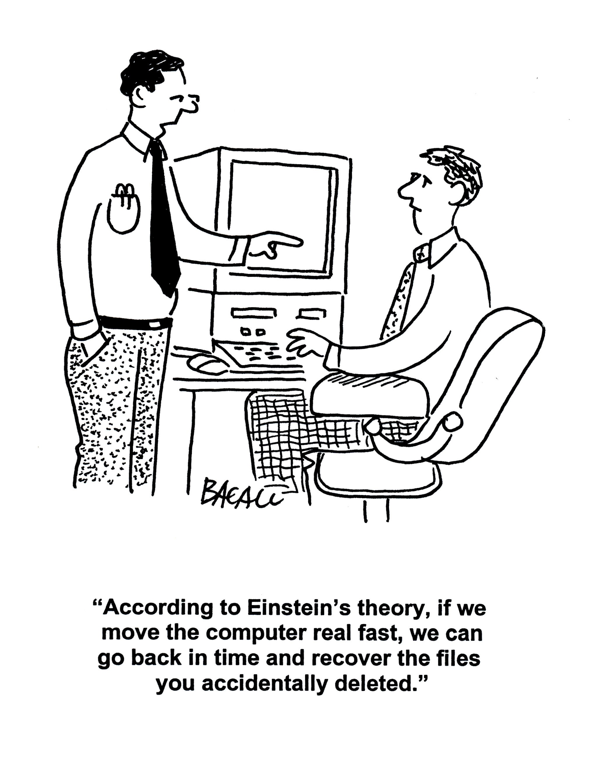
Recoverable
PERC
Tony Mason
Introduction Persistence Efficient Recoverable Consistent Conclusions

Slide 15
Allocation Benchmarks
PERC
Tony Mason
Single DIMM Configuration
Introduction
Persistence Efficient Recoverable Consistent Conclusions
Allocate, Free and Allocate
Allocate, Free and Allocate
5000
Allocate, Free and Allocate
1750
1500
1250
1000
750
500
250
jemalloc (DRAM)
nvm_malloc with CLWB nvm_malloc no fences/flushes pmcto_malloc
pmobj_malloc
1750
1500
1250
1000
750
500
250
jemalloc (DRAM)
nvm_malloc with CLWB nvm_malloc no fences/flushes pmcto_malloc
pmobj_malloc
jemalloc (DRAM)
nvm_malloc with CLWB nvm_malloc no fences/flushes
pmcto_malloc pmobj_malloc
4000
Time in ms
Time in ms
Time in ms
3000
2000
1000
0
2.5 5.0 7.5 10.0 12.5 15.0 17.5 20.0 22.5
0
2.5 5.0 7.5 10.0 12.5 15.0 17.5 20.0 22.5
0
2.5 5.0 7.5 10.0 12.5 15.0 17.5 20.0 22.5
Parallel Threads
Parallel Threads
Parallel Threads
Six-DIMM (striped) configuration
Allocate, Free and Allocate Allocate, Free and Allocate
5000
jemalloc (DRAM) jemalloc (DRAM)
jemalloc (DRAM)
Allocate, Free and Allocate
1200
nvm_malloc with CLWB nvm_malloc with CLWB
⁴⁰⁰⁰⁰ nvm_malloc with CLWB
1000
^{nvm_malloc no fences/flushes} 4000 ^{nvm_malloc no fences/flushes}
nvm_malloc no fences/flushes pmcto_malloc
pmobj_malloc
pmcto_malloc pmobj_malloc
pmcto_malloc pmobj_malloc
30000
Time in ms
800
Time in ms
3000
Time in ms
600
2000
20000
400
1000
10000
200
0
2.5 5.0 7.5 10.0 12.5 15.0 17.5 20.0 22.5
0
2.5 5.0 7.5 10.0 12.5 15.0 17.5 20.0 22.5
0
2.5 5.0 7.5 10.0 12.5 15.0 17.5 20.0 22.5
Parallel Threads
Parallel Threads
Parallel Threads

Slide 16
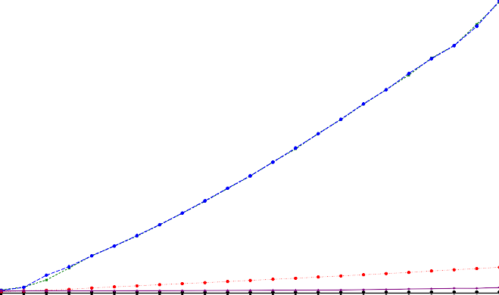
Allocation Benchmarks
PERC
Tony Mason
Introduction Persistence Efficient Recoverable Consistent Conclusions
Allocate, Free and Allocate
40000 | jemalloc (DRAM) nvm_malloc with CLWB
 | nvm_malloc no fences/flushes
30000 | pmcto_malloc pmobj_malloc
20000
10000
0
 | 2.5 | 5.0 7.5 10.0 12.5 Parallel Threads | 15.0 | 17.5 | 20.0 | 22.5
Time in ms

Slide 17
Micro Benchmarks
PERC
noflush, periodic sfence, same cache set
Tony Mason
40
35
30
25
20
15
10
5
0
Introduction
Persistence Efficient Recoverable Consistent Conclusions
CPU Ticks per operation
1
2
3
4 5 6 7 8 16
SFENCE frequency (once per N writes)
4 6 8 12 16 32 64
32
64
128
noflush, periodic sfence, different cache set
40
35
30
25
20
15
10
5
0
CPU Ticks per operation
1
2
3
4 5 6 7 8 16
SFENCE period (once per N writes)
4 6 8 12 16 32 64
32
64
128

Slide 18
Micro Benchmarks
PERC
Linked List + Write (No Flush)
70
60
50
40
30
20
10
0
4 6 8 12 16 32 64
Page Count (one list entry per page)
Tony Mason
CPU Ticks Per operation
Introduction
Persistence Efficient Recoverable Consistent Conclusions
initialize
walk + prefetch
walk + sfence each run
walk
walk + sfence each write
Linked List + Write (Including Flush)
CPU Ticks Per operation
6000
4000
2000
0
4 6
8 12 16
Page Count (one list entry per page)
32
64
initialize
walk + prefetch
walk + prefetch + clflush
walk
walk + clflush
walk + sfence each write
walk + sfence each run

Slide 19
Micro Benchmarks
PERC
Tony Mason
Introduction
Persistence Efficient Recoverable Consistent Conclusions
clwb, periodic fence, same cache sets
40
35
30
25
20
CPU Ticks per operation
15
10
5
0
1
2
3
4 5 6 7 8 16
SFENCE period (once per N writes)
4 6 8 12 16 32 64
32
64
128

Slide 20
Micro Benchmarks
PERC
Tony Mason
Introduction
Persistence Efficient Recoverable Consistent Conclusions
clwb, periodic fence, same cache sets
40
35
30
25
20
CPU Ticks per operation
15
10
5
0
1
2
3
4 5 6 7 8 16
SFENCE period (once per N writes)
4 6 8 12 16 32 64
32
64
128

Slide 21
Micro Benchmarks
PERC
clflush, periodic sfence, different cache set
Tony Mason
45
40
35
30
25
20
15
10
5
0
CPU Ticks per operation
Introduction
Persistence Efficient Recoverable Consistent Conclusions
1
2
3
4 5 6 7 8 16
SFENCE period (once per N writes)
6 8 12 16 32
32 64 128
4
64
clflush, periodic sfence, same cache set
120
100
80
60
40
20
0
CPU Ticks per operation
1
2
3
4 5 6 7 8 16
SFENCE period (once per N writes)
4 6 8 12 16 32 64
32 64 128

Slide 22
Micro Benchmarks
PERC
Tony Mason
NVM Flush/Fence Behavior
18
17
Introduction
Persistence Efficient Recoverable Consistent Conclusions
CPU Ticks/operation
16
15
14
13
12
6
8
12
16
32
64
noflush, nofence, same cache set noflush, nofence different cache set noflush, sfence end, same cache set noflush, sfence end, different cache set
clflush, nofence, same cache set clfush, nofence, different cache set clflush, sfence end, same cache set clflush, sfence end, different cache set
Number of Pages
clflushopt, nofence, same cache set clflushopt, nofence, different cache set clflushopt, sfence end, same cache set clflushopt, sfence end, different cache set
clwb, nofence, same cache set clwb, nofence, different cache set clwb, sfence end, same cache set
clwb, sfence end, different cache set
eNVM Flush/Fence Behavior
18
17
CPU Ticks/operation
16
15
14
13
12
6
8
16
Number of Pages
32
64
noflush, nofence, same cache set noflush, nofence different cache set noflush, sfence end, same cache set noflush, sfence end, different cache set
clflush, nofence, same cache set clfush, nofence, different cache set clflush, sfence end, same cache set clflush, sfence end, different cache set
clflushopt, nofence, same cache set clflushopt, nofence, different cache set clflushopt, sfence end, same cache set clflushopt, sfence end, different cache set
clwb, nofence, same cache set clwb, nofence, different cache set clwb, sfence end, same cache set
clwb, sfence end, different cache set

Slide 23
Outline
PERC
Tony Mason
1
Introduction
Introduction
Persistence Efficient Recoverable Consistent Conclusions
2
Persistence
3
Efficient
4
Recoverable
5
Consistent
6
Conclusions

Slide 24

Consistent
PERC
Tony Mason
Introduction Persistence Efficient Recoverable Consistent Conclusions

Slide 25
Consistent
PERC
Tony Mason
Single DIMM Configuration
Introduction
Persistence Efficient Recoverable Consistent Conclusions
Linked List Creation
1750
Linked List Creation
4000
Linked List Creation
¹⁷⁵⁰ jemalloc (DRAM)
jemalloc (DRAM) nvm_malloc with CLWB
nvm_malloc no fences/flushes pmcto_malloc
pmobj_malloc
jemalloc (DRAM)
³⁵⁰⁰ nvm_malloc with CLWB
3000
2500
2000
1500
1000
500
1500
1250
1000
750
nvm_malloc with CLWB
1500
1250
1000
750
500
nvm_malloc no fences/flushes pmcto_malloc
pmobj_malloc
nvm_malloc no fences/flushes
pmcto_malloc pmobj_malloc
Time in ms
Time in ms
Time in ms
500
250
250
0
2.5 5.0 7.5 10.0 12.5 15.0 17.5 20.0 22.5
Parallel Threads
0
2.5 5.0 7.5 10.0 12.5 15.0 17.5 20.0 22.5
0
2.5 5.0 7.5 10.0 12.5 15.0 17.5 20.0 22.5
Parallel Threads
Parallel Threads
Six-DIMM (striped) configuration
Linked List Creation
3000
Linked List Creation
Linked List Creation
jemalloc (DRAM)
1750
jemalloc (DRAM) nvm_malloc with CLWB nvm_malloc no fences/flushes pmcto_malloc
pmobj_malloc
₃₅₀₀₀ jemalloc (DRAM)
nvm_malloc with CLWB
2500
nvm_malloc with CLWB nvm_malloc no fences/flushes
1500
1250
1000
750
500
250
0
nvm_malloc no fences/flushes
30000
25000
20000
15000
10000
5000
0
pmcto_malloc pmobj_malloc
2000
pmcto_malloc pmobj_malloc
Time in ms
Time in ms
1500
Time in ms
1000
500
2.5 5.0 7.5 10.0 12.5 15.0 17.5 20.0 22.5
0
2.5 5.0 7.5 10.0 12.5 15.0 17.5 20.0 22.5
2.5 5.0 7.5 10.0 12.5 15.0 17.5 20.0 22.5
Parallel Threads
Parallel Threads
Parallel Threads

Slide 26
Outline
PERC
Tony Mason
1
Introduction
Introduction
Persistence Efficient Recoverable Consistent Conclusions
2
Persistence
3
Efficient
4
Recoverable
5
Consistent
6
Conclusions

Slide 27
Lessons
PERC
Tony Mason
Introduction
Persistence Efficient Recoverable Consistent Conclusions
Flush aggressively, fence conservatively

Slide 28
Lessons
PERC
Tony Mason
Introduction
Persistence Efficient Recoverable Consistent Conclusions
Flush aggressively, fence conservatively
flushing fills the pipeline
fencing ensures persistence

Slide 29
Lessons
PERC
Tony Mason
Introduction
Persistence Efficient Recoverable Consistent Conclusions
Flush aggressively, fence conservatively
flushing fills the pipeline
fencing ensures persistence
Write Efficiently

Slide 30
Lessons
PERC
Tony Mason
Introduction
Persistence Efficient Recoverable Consistent Conclusions
Flush aggressively, fence conservatively
flushing fills the pipeline
fencing ensures persistence
Write Efficiently
(Sequential) Read is fast.
Write is slow — beware write amplification

Slide 31
Lessons
PERC
Tony Mason
Introduction
Persistence Efficient Recoverable Consistent Conclusions
Flush aggressively, fence conservatively
flushing fills the pipeline
fencing ensures persistence
Write Efficiently
(Sequential) Read is fast.
Write is slow — beware write amplification
Optimize NVM/DRAM Usage
Use NVRAM for data that must be persistent Use DRAM for ephemeral operations NVRAM /= DRAM

Slide 32
Questions?
PERC
Tony Mason
Introduction Persistence Efficient Recoverable Consistent Conclusions

